Slide 1
Mitigating Hallucinations in Generative AI

Slide 2
Hallucinations in Generative AI
Factual Inaccuracies
Ethical and Safety Concerns
Semantic and Contextual Errors
Factually Incorrect statements
Mis-leading information
Confusing conclusions
Loosing trust and reputation
Bias and discrimination
Harmful content
Economic and social implications
Data leakage or privacy breaches
No logical sense
Inappropriate information
Poor user experience and reduced user engagement
Inferior decision making
Notes:
Now let’s talk about the dimensions of responsible AI.
What constitutes responsible AI is being debated globally and is continually evolving. For AWS, we define responsible AI as being made up of six key dimensions: Bias and fairness, explainability, robustness, privacy and security, governance, and transparency. While this is our definition today, we will continue to iterate as the science and engineering of responsible AI mature.
Bias and Fairness – Here we consider how a system impacts different subpopulations of users (e.g. by sex, ethnicity, language). We want to make sure that there are not harmful disparities in system performance across subpopulations.
Explainability – Whether the system offers a clear rationale for its decisions. Customers want justification for the inference produced by the AI system which is particularly important for those with compliance requirements.
Robustness – We’d like confidence that the AI systems cannot be easily fooled or confused. Success here means at the least that we have understandable guidelines for when the system is expected to work.
Privacy and Security – Privacy and security are the highest priority at AWS for any service, AI or not. Use of ML brings potential risks to customer content and Amazon IP that may require preventive and mitigating steps beyond those taken in the normal course of protecting privacy and security.
Governance – Processes to enforce and ensure responsible AI practices are being carried out amongst all stakeholders.
Transparency – The extent to which an organization enables customers and end-users to know whether or not they are using an ML-based application, and to make informed choices about their use of the ML application.

Slide 3
Challenges of Hallucination
Misleading Summaries
Inaccurate summaries/text generation could lead to detrimental outcomes
Negative economic impact Turbulences in the markets due to generated inaccurate financial indicators
Losing Customer Trust Diminishing user engagement and increasing frustrations due to inaccuracies
Bias and Safety Concerns Amplifying societal biases
Notes:
Responsible AI isn’t a point solution. It requires an end-to-end approach that covers the entire AI lifecycle, from data to development to deployment. AWS services help users better detect bias in data sets and models, provide insights into model predictions, and better monitor and review model predictions through automation and human oversight.
Services and tools
• Data preparation services, such as Amazon SageMaker Data Wrangler, SageMaker Ground Truth, and SageMaker Ground Truth Plus, play a key role in Responsible AI by verifying and labeling data accurately with human review, right from the start. • Amazon SageMaker Clarify helps mitigate bias by detecting potential bias during data preparation, after model training, and in a deployed model by examining specific attributes.
• Amazon Model Monitor automatically detects and alerts users to inaccurate predictions from models deployed in production.
We continue to expand our portfolio of services and tools to meet the needs of our customers.
Amazon expert teams
AWS has hundreds of experts committed to Responsible AI, including teams within our AWS Professional Services organization and beyond—all providing guidance and expertise throughout the AI/ML lifecycle
• Our experts include dedicated, diverse, industry-leading experts from academia, public, and private sectors.
• Machine Learning Solutions Lab provides assistance, helping our customers achieve their specific goals with AI, responsibly.
• We partner with leading thinkers, researchers, and academics, who serve as AWS Fellows, bringing outside perspectives, expertise, and experience to the challenges of AI.
For example, a team of AWS experts wholly committed to providing best practices and developing a rigorous methodology to build AWS AI and ML services in a responsible way. This team also evaluates specific customer use-cases to ensure responsible use of AI delivers deep expertise via direct collaboration with our customers.

Slide 4
Why Large Language Models hallucinate?
Noisy/Biased data
Gaps in model knowledge
Incomplete Data
Overfitting
Model bias
Parameter Settings
Lack of Ground truth
Missing real time feedback loops
No real world context
Ambiguous Prompts
Broad range of potential responses
Data Quality
Training
and Inference
Integrations
Ambiguous Inputs
Notes:
AI is tackling some of humanity’s most challenging problems, improving customer experiences, and spurring new innovations. According to IDC, global spending on AI-based technologies will reach $204 billion by 2025. Machine learning is increasingly playing a role in every part of an organization from powering chatbots to delivering personalized recommendations.
With that growth of AI comes the recognition that we must all use it responsibly.

Slide 5
Evaluating Hallucinations in Generative AI

Slide 6
Datasets to evaluate
SQuAD
(Stanford Question Answering Dataset) Primarily for question answering
Natural Questions (NQ)
FEVER
WikiReading
Based on real world questions
(Fact Extraction and VERification) Unique focus on fact verification
Wikipedia and Wikidata from encyclopedia texts
Build Your Own – Synthetic data specific to your requirements
Notes:
Continuous education on the latest developments in ML is an important part of responsible use. AWS offers the latest in ML education through programs like the AWS Machine Learning University (offered free to all), our Training and Certification program, and AWS ML Embark.

Slide 7
Metrics to Evaluate
BLEU
ROUGE
(K)F1-Score
METEOR
Traditional
FACTacc
Distinct-N
FEVER score
Exact Match
Supporting/Refuting Evidence Match score
Emerging
Notes:
BLEU, ROUGE, METEOR, and other reference-based metrics compare generated text to a reference text. While they don't directly measure hallucinations, significant deviations from reference texts can be indicative of potential hallucinations.
Evaluating hallucinations is challenging because it's not just about factual accuracy but also about ensuring the generated content aligns with the input's intent and context. So, custom dataset preparation might be helpful based on the domain and you can combine with the traditional comparision of the generated text to a reference text using those metrics
Introduce these metrics - common

Slide 8
Evolving strategies to mitigate hallucinations in Generative AI

Slide 9
Strategies to mitigate Hallucinations
Parameter Tuning - Adjust top_p/top_k and temperature
Retrieval Augmented Generation
Prompt Engineering
Agents/Fact Tools
Fine Tuning
Fine-tuning on domain-specific data and tasks can update their parameters to better model verifiable knowledge and relationships
Implement Prompt techniques like Chain of thought reasoning, examples, evidences, seeking confirmations
Connect externally through APIs/other LLMs, retrieve evidence, test logic, provide feedback and orchestrate
Evidentiary support to improve factual accuracy by retrieving and integrating relevant passages, facts, and knowledge from external sources
9

Slide 10
Customize parameters for accurate results
Temperature regulates unpredictability. Lower values favor more probable tokens potentially producing deterministic outputs
Adjusting Top_k can provide balance between randomness and determinism
Top_p also adjusts determinism with "nucleus sampling". Lower values give exact answers, higher values give diverse responses
Generally only adjust one parameter at a time
Outcomes vary between language model types
10

Slide 11
Prompt Engineering for Accurate Outputs
Adversarial Prompt techniques
Chain of Thought
Explicitly Ask for Accuracy
Negative Prompting
Reasoning Steps
Q: What is the capital city of Australia, please provide your Chain of thought and some evidence to support?
A: To identify the capital city of Australia, …. Looking at encyclopedia, it confirms that ..
Guide Model to explicitly remove bias, errors, refine scope, not to over generalize
Add emphasis on fact checks
Provide a factually accurate info on photosynthesis
Design prompts intended to challenge the model and expose its weaknesses
Determine the correct and accurate responses
11

Slide 12
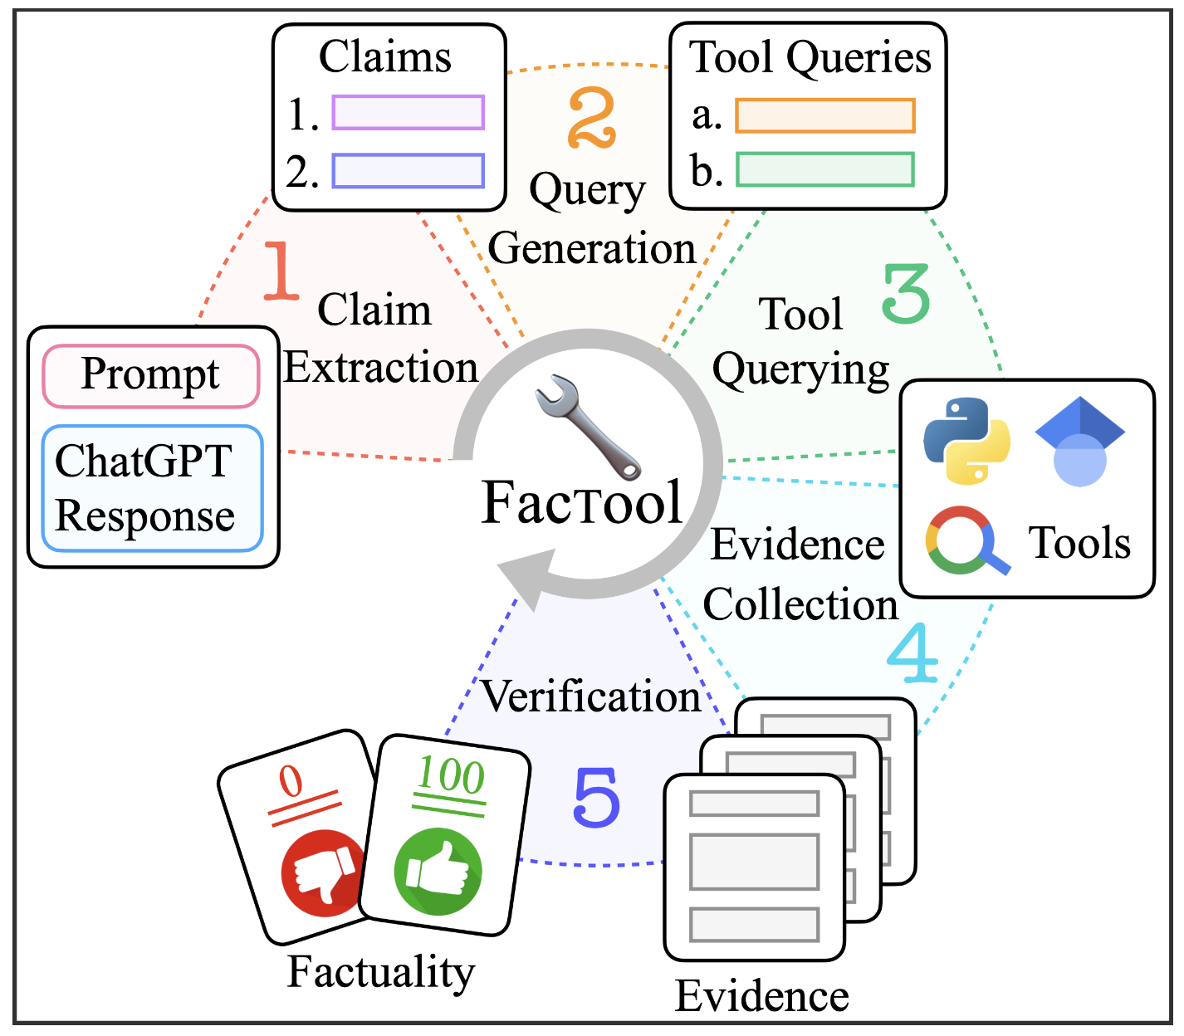
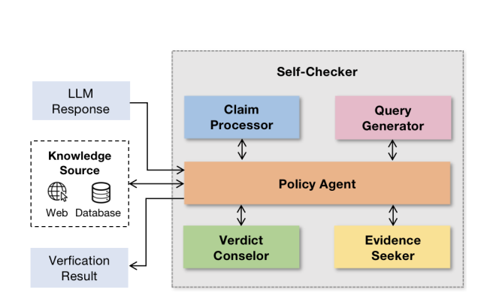
Use Agents/Tools to verify claims
Ex – FACTool, Self-checker
Source - https://arxiv.org/abs/2307.13528
Source - https://arxiv.org/pdf/2305.14623.pdf
Notes:
The application of artificial intelligence (AI) and machine learning (ML) to contact centers improves efficiency and effectiveness resulting in better customer experience and reduce cost. These technologies are helping to transform the modern contact center from a cost center into a profit center.
To add AI into your contact center, AWS offers you flexible options.
Amazon Connect is our single, unified omnichannel cloud contact center. It natively offers solutions such as self-service Conversational IVRs and Chatbots. There’s also Contact Lens for Amazon Connect which includes real-time and post-call analytics powered by machine learning.
Then, there are Contact Center Intelligence (CCI) solutions that enable you to augment your existing contact center investments with AWS machine learning (ML) capabilities to gain greater efficiencies and deliver increasingly tailored customer experiences —with no ML expertise required. You can engage an AWS CCI Partner and accelerate deployment with a turnkey solutions or if you need a custom solution, we have a set of consulting partners to help build what you need.
AWS CCI solutions can be applied to these 3 main use cases:
1. Self-service virtual agents includes conversational IVRs and chatbots deflect calls by enable users to quickly find answers and complete transactions on their own, without the assistance of a live agent. These solutions can also identify the intent of a caller and direct them to the proper agent and reduce the number of call transfers. 2. Real-time call analytics and Agent Assist - With CCI, we’re focused on relieving the burden on the agent who’s on the front line communicating with the customer. With real-time call analytics, CCI solutions can process these live conversation and understand the context of the call and with Agent-Assist, reduce agent fatigue from information overload and provide them with real time suggestions for answers pulled from a knowledge base or other data sources. With real-time analytics, customer sentiment can be monitored and supervisors can be alerted to jump in and help their agents with calls that may not be going well. This solution can help to reduce agent call-handling time and reduce agent churn with effective real-time information.
3. Post Call analytics solutions enables you to process 100% of your historic customer interactions which gives you comprehensive coverage of all of your customer conversations. Post-call analytics enables you to gain insights such as emerging trends, customer sentiment, and call drivers, plus it can help to identify customer service and business improvement opportunities. With those insights, you can better understand your customers and derive solutions to help solve their problems faster. You can also setup analytics to assess agent performance and monitor script compliance.
Benefits:
AWS Contact Center Intelligence (CCI) solutions empower you to improve customer experience, boost agent productivity, reduce operational costs and gain conversation insights by adding AI capabilities to the contact center of your choice —without any ML expertise.
Increase customer satisfaction : Reduce call wait times; Quickly route questions to the right agent; Decrease time to resolution; Improve NPS/CSAT scores with faster, more effective customer service.
Boost agent productivity: Reduce call volume; Offload repetitive queries to virtual agents; Enable real-time assistance round the clock; Promote high performing agents & train slow learners; Improve employee retention thus reducing operational costs
Uncover business opportunities: Reduce costs via self-service technologies; High-quality insights on customer satisfaction, emerging trends, and product performance; Monitor call script compliance.
CCI is a horizontal solution that can be applied to all industries. Some of the key industries where we have seen success include: Financial services & Insurance, Retail and eCommerce, Public sector, Healthcare, and Travel & Hospitality.

Slide 13




RAG – Retrieval Augmented Generation
Question + Context
LLM Endpoint
Answer
Enhancing Reliability and Accuracy
User
Context
Retrieve relevant documents
Validate model outputs with sources of the generated content to enhance the accuracy and reliability
Knowledge base
Document Store
FAQs, Wiki…
New Data
Vector DB
Embeddings Endpoint
Notes:
An Open book exam

Slide 14

Tune for Accuracy
Fine-tune
Domain specific
fine-tuning
Verification
fine-tuning
Knowledge Aware Response Planning
Technique
Causal Reasoning fine-tuning
Causal relationships between events and effects
Absorb entities &
relationships
Factual Dataset to validate claims
Strategy to exploit the retrieved external knowledge
Benefit
Notes:
Customers can fine-tune Bedrock’s FMs by providing a few hundred labeled examples, making it possible to create an accurate customized model for their specific problem without the burden of collecting large volumes of annotated data.
Customers can easily start fine-tuning by pointing Bedrock to their datasets in their S3 bucket.
To give an example, imagine a content marketing manager that works at a leading shoe retailer. They want to develop new ad creatives for an upcoming new line of shoes. To do this, they can provide a few examples of their best performing ad creatives from past social media campaigns along with the associated product descriptions to Bedrock. Bedrock’s customized FM can now automatically generate an effective social media ad based on the product description for the new shoe, enabling the content marketing manager to get a ready-to-use ad creative immediately.
https://www.amazon.science/publications/efficient-fine-tuning-large-language-models-for-knowledge-aware-response-planning

Slide 15
Choosing the appropriate technique
Prompt Engineering Guiding model to generate useful response by teaching it the “pattern” of desired output using context instructions, examples and output indicators
Retrieval Augmented Generation (RAG) Text generation based on specified corpus of data, to generate accurate responses with reduced hallucinations
Agents/Tools for facts Connect externally through APIs, retrieve evidence, test logic, provide feedback and orchestrate
Fine-tuning Refine a model with new insights, specialized domain data, or enhanced information from adversarial prompts to enhance output precision and produce appropriate outcomes.
Retrain the model Retraining a model using better datasets, or building a model from scratch
Increasing cost and complexity
15
Notes:
As an evolving topic, responsible AI can seem abstract. But there are very specific steps you can take to deepen your knowledge of responsible AI—and explore how it integrate it into your organization.

Slide 16
More Strategies
CONTINUOUS IMPROVEMENT
Diverse and high quality fact checked data for model training
Regular evaluation on both adversarial and standard prompts
Audit and address bias
Define intrinsic and extrinsic metrics
Embed human in the loop for critical applications
Best Practices
Fairness and Model Explainability
Detect potential bias and explain the predictions
Feedback Mechanisms
Incorporate user feedback if the generated text is appropriate
Guardrails
Predefine constraints and guidelines in the desired boundaries
Knowledge Graph Retrieval-Augmentation
Augmenting prompts with retrieved relationships between entities

Slide 17
Hands-on Demo

Slide 18

Scan for slides

